Slide 1

Artificial Intelligence
Lecture 9
By/ aly maher abdelfattah

Slide 2
What is Computer Vision?
Vision is a perceptual channel that accepts impulse and reports some representation of the world.
Most agents that use vision use passive sensing—they do not need to send out light to see.
In contrast, active sensing involves sending out a signal such as radar or ultrasound, and sensing a reflection.
Bats (ultrasound), dolphins (sound), and some robots (light, sound, radar).
Computer vision is the science and technology of machines that see.
Concerned with the theory for building artificial systems that obtain information from images.
The image data can take many forms, such as a video sequence, depth images, views from multiple cameras, or multi-dimensional data from a medical scanner

Slide 3
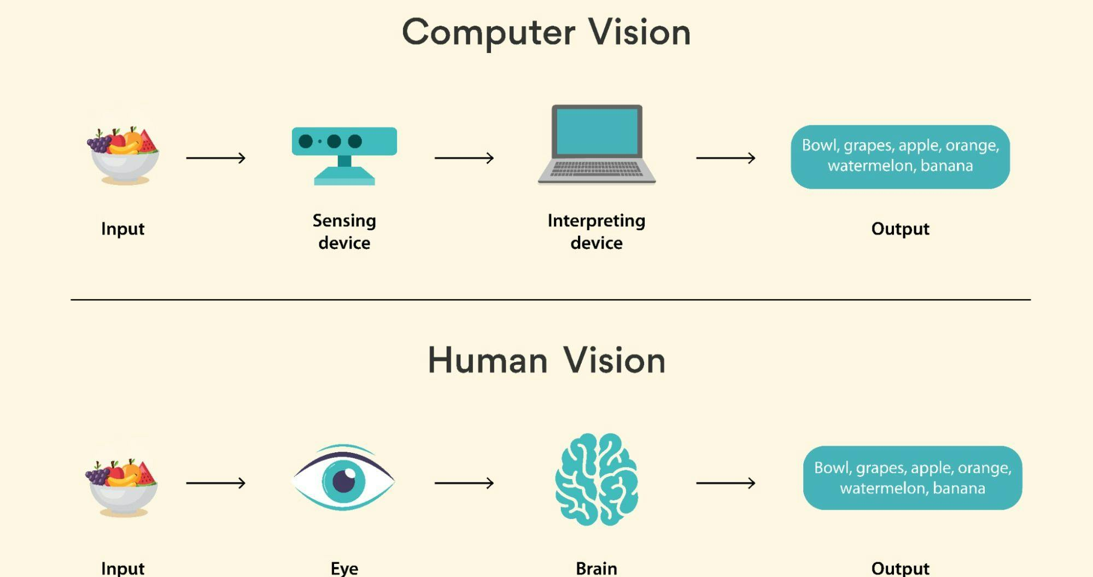
How does Computer Vision work?

Slide 4
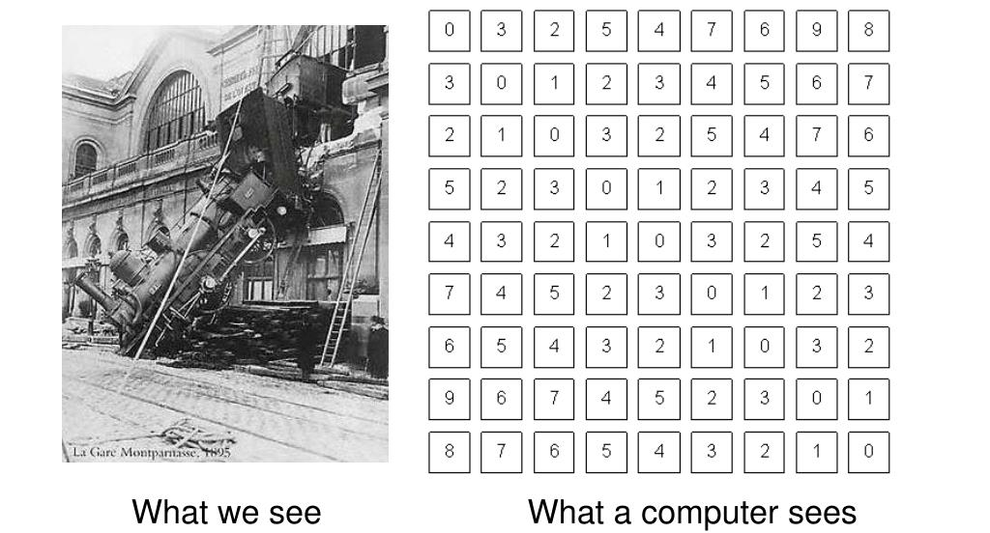
Computer Vision vs human vision

Slide 5
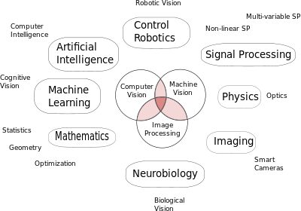
Vision is multidisciplinary

Slide 6
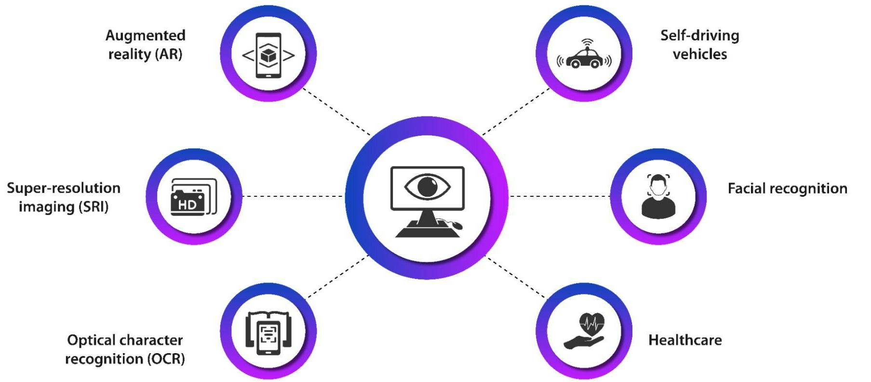
Computer Vision applications

Slide 7
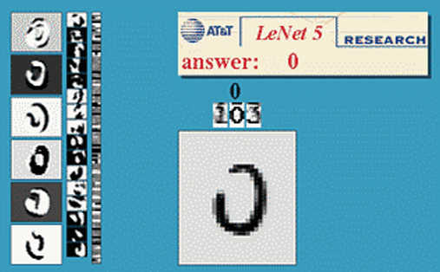
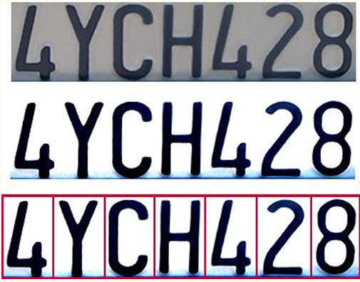
Optical character recognition (OCR)
Technology to convert scanned docs to text
If you have a scanner, it probably came with OCR software
Digit recognition, AT&T labs
License plate readers

Slide 8
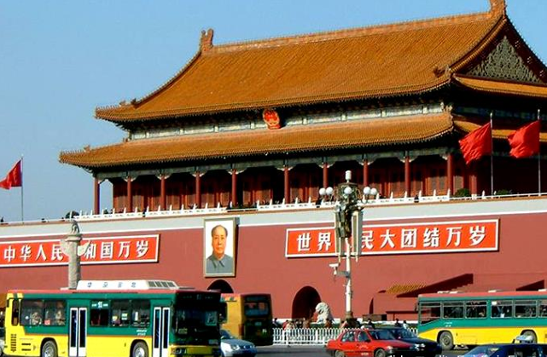
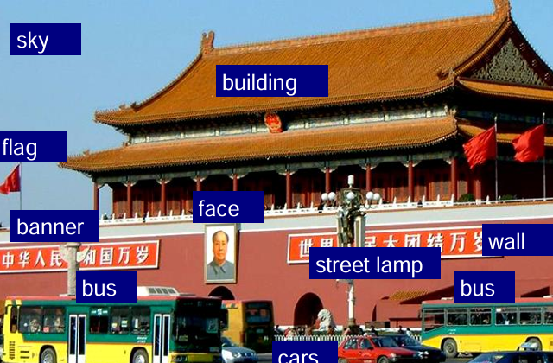
Vision as a source of semantic information
Object categorization

Slide 9
Main Problems
The two core problems of computer vision are:
Reconstruction, where an agent builds a model of the world from an image or a set of images, and
Recognition, where an agent draws distinctions among the objects it encounters based on visual and other information.
Image plane is subdivided into a grid of a few million pixels.

Slide 10
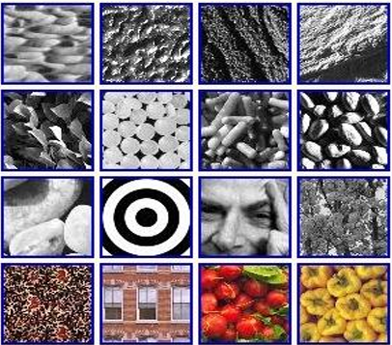
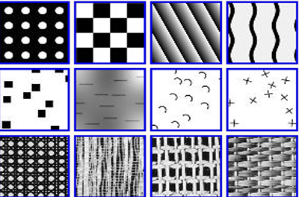
Image Feature
A feature is a number obtained by applying simple computations to an image. Very useful information can be obtained directly from features.
Edges are straight lines or curves in the image plane across which there is a “significant” change in image brightness.
Texture In computational vision, texture refers to a pattern on a surface that can be sensed visually. Usually, these patterns are roughly regular.

Slide 11
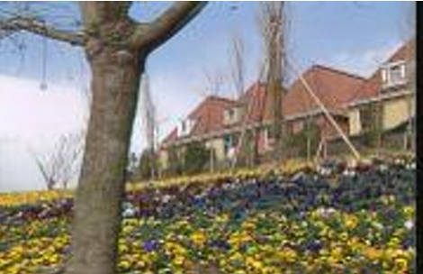
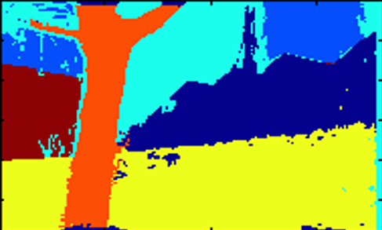
Region Segmentation
Segmentation is the process of breaking an image into groups of similar pixels. The basic idea is that each image pixel can be associated with certain visual properties, such as brightness, color, and texture.

Slide 12

Thank you

